Slide 1
Monitoring and Evaluation System for ICCR’s Regional Offices(ROs)
Shreya Chinchmalatpure (2046491245048)
Ashwini Ukhalkar (2046491245008)
Purva Dhopade (2046491245034)
Prof. Abhishek Kinhekar
Assisstant Professor

Slide 2
Introduction
Online Monitoring and Evaluation System for ICCR’s Regional Offices(ROs).
ICCR would like to monitor all its Regional Offices in India on real-time basis for all the activities they do. This will help ICCR to implement its activities effectively and thus, evaluate their performances in real-time.
The main objective of the project is:-
To foster and strengthen cultural relations and mutual understanding between India and other countries,
To promote cultural exchanges with other countries and people, and to develop relations with other nations.

Slide 3
Objectives of Project
Monitor all activities of ICCR’s Regional Offices and evaluate their performances on real-time basis.
Look after the interest of foreign students studying in various states of India.
Keep track of Monetary Information spent on students and other establishment expenditure.
Develop mechanism to coordinate with local cultural and educational organizations and the State Government for carrying out ICCR’s mandate of activities.
To encourage active discussions and interaction between scholars and those interested in Indian languages, culture and heritage by organizing Seminars, Conferences and Workshops abroad.

Slide 4




Stakeholders
ICCR
Students
Regional Office
Institute

Slide 5
Literature Survey
Sr. No | Module | Summary
1. | “Indian Council For Cultural Relations – Overview” | It give a overview of the ICCR’s objectives which is to foster harmony and encourage people interactions between India and other countries and project its distinct cultural identity all over the world.
2. | Official website of Indian Council for Cultural Relations, Government of India : “ICCR-Feedback” | It describes the feedback mechanism, in the form of feedback form ,which can be used to improve the quality of the events.
3. | Official website of Indian Council for Cultural Relations, Government of India : “ICCR-Scholarship” | It gives the details of scholarships given to the foreign students who wish to gain knowledge of the Indian culture.
4. | Official website of Indian Council for Cultural Relations, Government of India : “ICCR-Report 2020-21” | This is a overall report of the events which were conduction in the academic year of 2020-21.International events like yoga day in Nepal, Sanskrit day in Myanmar and sessions on Ayurveda Therapy in Mexico

Slide 6
Proposed Solution
A web portal for ICCR’s(Indian Council for Cultural Relations) with dashboard and options to manage Regional Offices and at the same time evaluate their activities.
RO’s (Regional Offices) will have a dashboard for scheduling activities and upload reports of the events conducted in form of photos, videos ,feedback system of the event and number of attendees
It will contain rating mechanism to rate the performance of RO’s which will be based on some parameters like number of events conducted, feedback from international students and local participants of the events
Sharing of feedback form links will be done by Regional Offices amongst participants of events conducted for improving the quality of events.
Facility of generating the monthly activity report and a real time analytics of events will be provided to ICCR.
Web Portal showcasing all upcoming activities of all Regional Offices of ICCR’s, for maximum participation from all the stakeholders

Slide 7
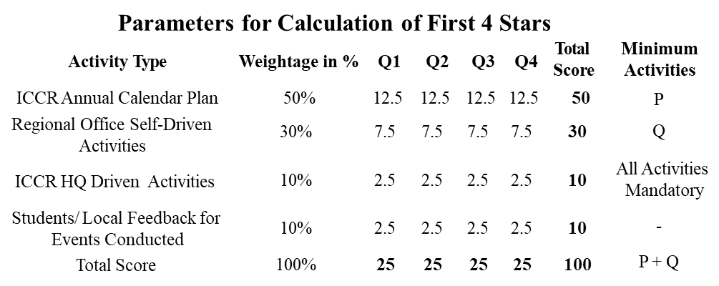

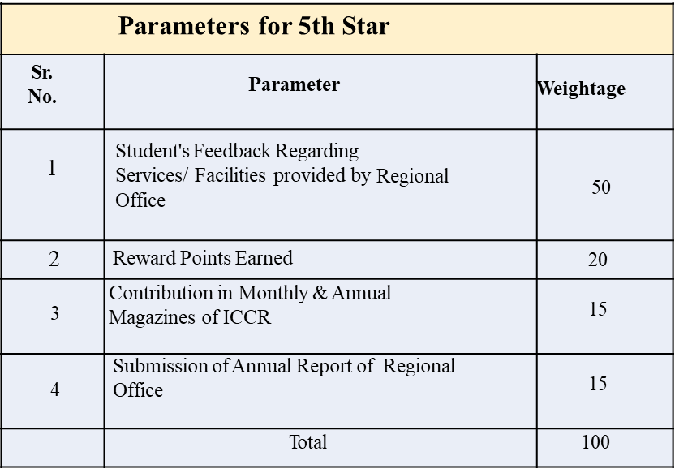
Online Performance and Evaluation System

Slide 8
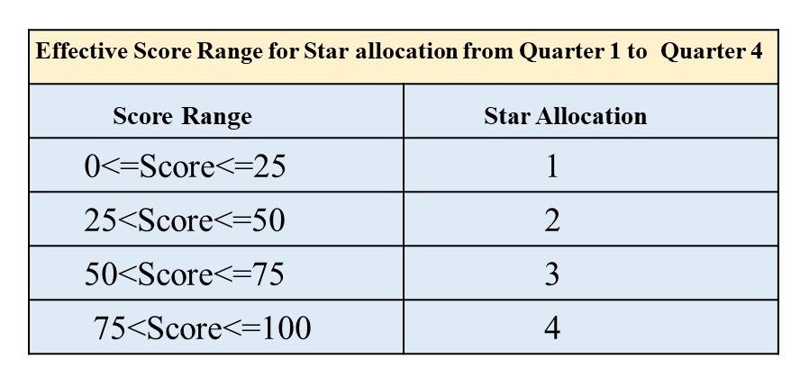
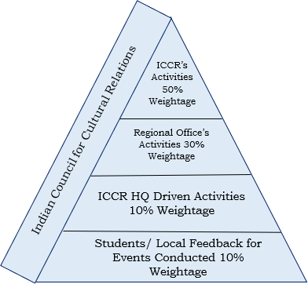
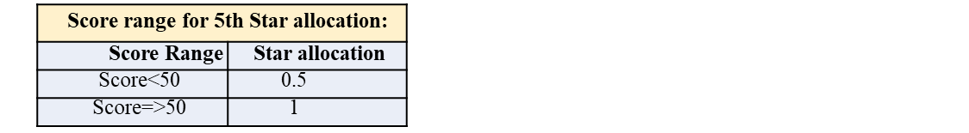
Online Performance and Evaluation System

Slide 9
ICCR Activities
The ICCR will prescribed an Annual Calendar (Quarter-wise Schedule) of activities for regional office.
To Create the Online Monitoring and Evaluation System for ICCR’s Regional Offices(ROs), the solution proposes to divide the activities in three different types. The activities are classified as:
1.ICCR Annual Calendar Activity: Regional Office have to select minimum number of prescribed activities from annual calendar, conduct them and upload their report.
2.Self-Driven Activities: Regional Offices are situated in states with diverse cultures, thus regional offices are encouraged to conduct self-driven activities promoting regional culture.
3.ICCR HQ Driven Activities: The ICCR HQ at national level may also conduct activities different from Annual Calendar, RO’s will participate in those activities and upload its report.

Slide 10
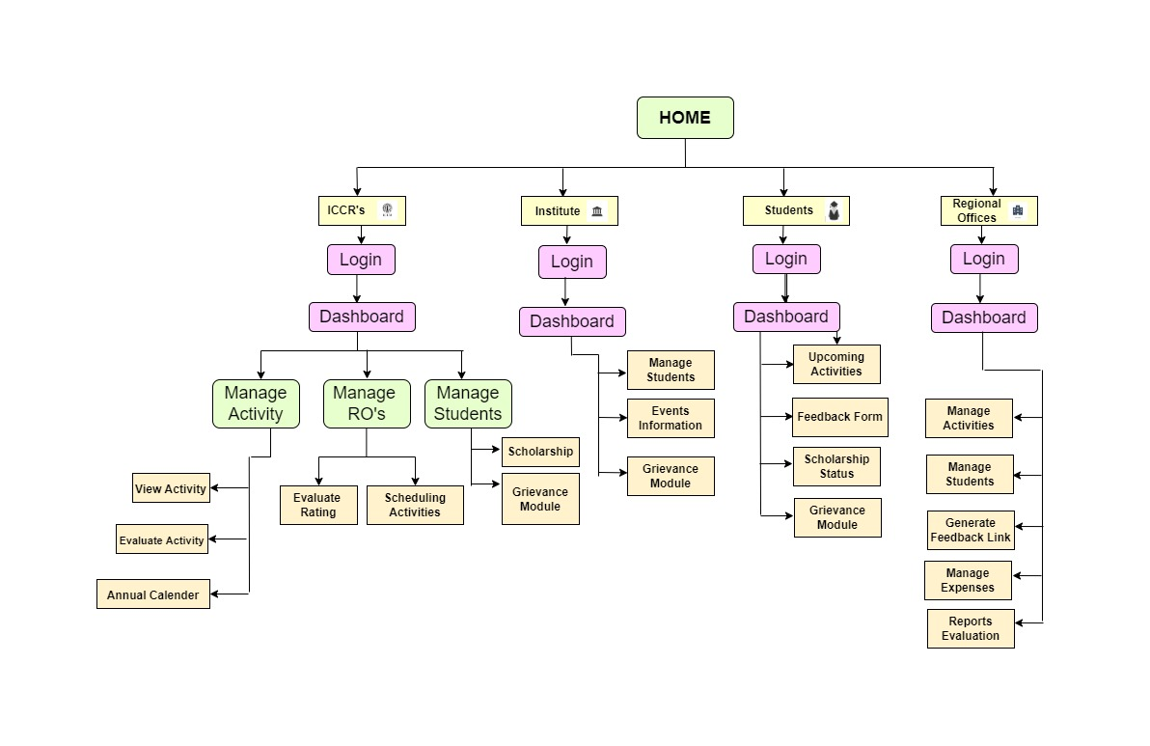
Process Flow

Slide 11
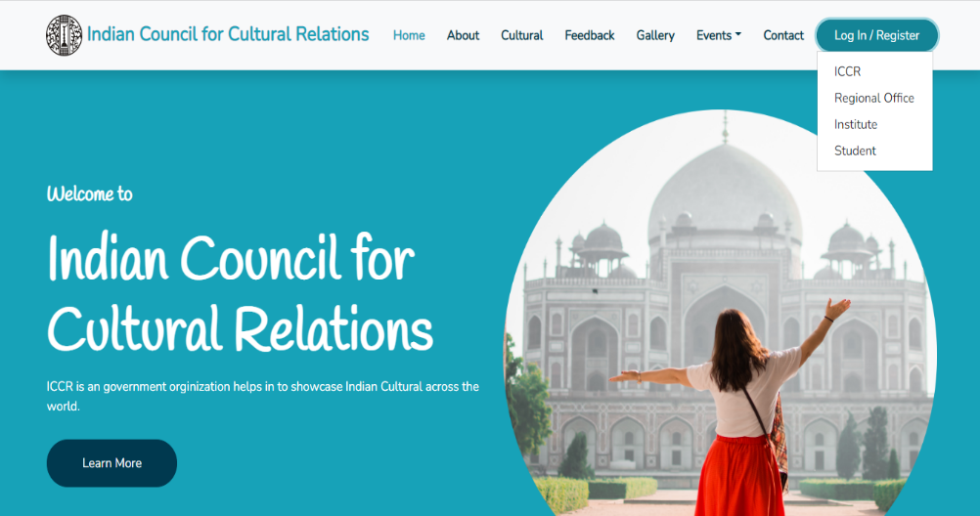
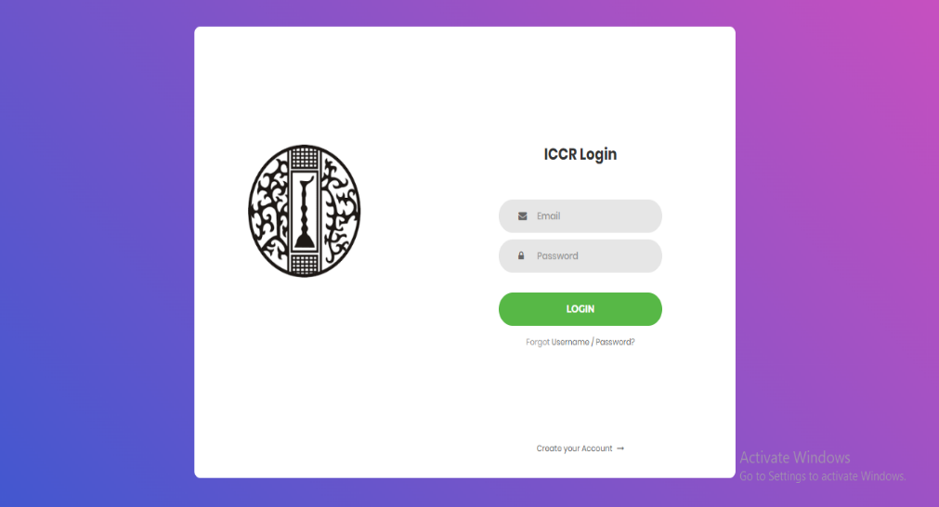
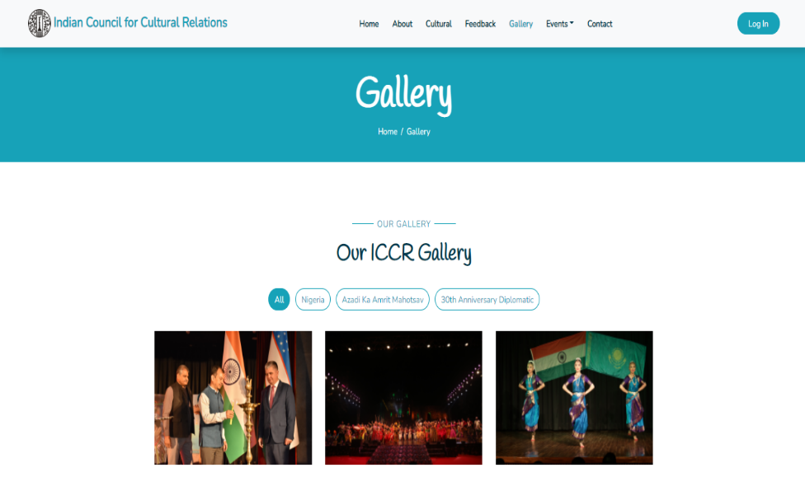
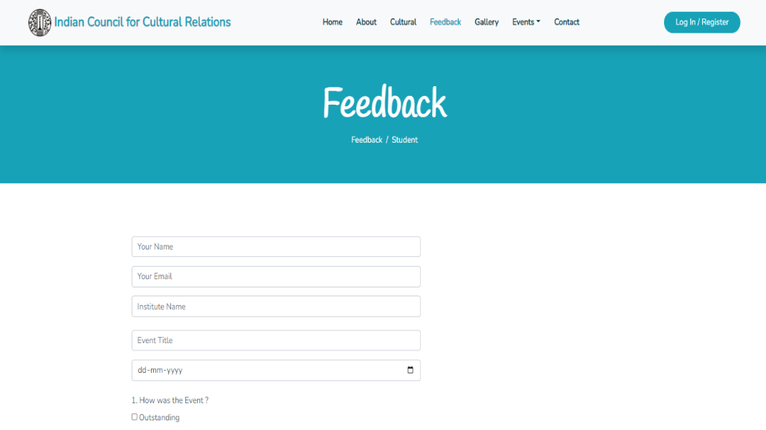
Snapshots

Slide 12






Technologies Used

Slide 13
Conclusion
This website will help ICCR to monitor activities performed by regional offices and help them rate their performance.
The website will also help generate Self-Driven Activities which are conducted by Regional Offices & ICCR HQ Driven Activities conducted at national level including monthly and annual activities & Financial Reports.
The feedback received from International students will help ICCR devise better student friendly policies, thus fostering and strengthening cultural relations and mutual understanding between India and other countries, promoting cultural exchanges with other countries and people, and developing relations with nations thus, improving students participation in cultural activities.

Slide 14
References
Indian Council for Cultural Relations, Wikipedia, https://en.wikipedia.org/wiki/Indian_Council_for_Cultural_Relations#Publications, Oct 3,2022
Official website of Indian Council for Cultural Relations, Government of India, https://iccr.gov.in/about-us, Oct 3,2022
ICCR Annual Report: Indian Council for Cultural Relations Azad Bhawan, I.P. Estate, New Delhi, 2020-21

Slide 15
Thank You.

Slide 16
Project Timelines
Sr.no | Dates | Expected work done
1 | 24th Sep’22 | Finalization of the Topic
2 | 4th Oct ‘22 | First Evaluation Round
3
4

